Slide 1
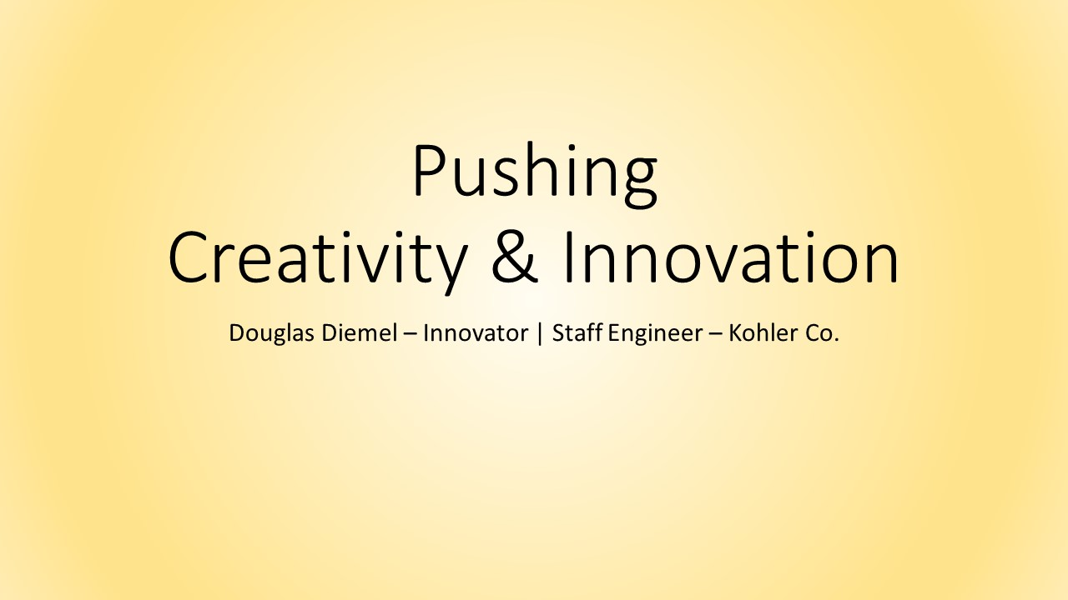
Notes:
This presentation / Ted Talk was shared with several business groups at Kohler, and is now updated to be shared outside with the world.
Created and originally presented by Douglas Diemel, Innovator | Staff Engineer for Kohler’s Smart Home Group
Questions or comments please email or message me anytime

Slide 2

Notes:
About me, I am a huge fan of innovation, and I feel blessed to work at a company who’s CEO is passionate about “Living on the Leading Edge of Design and Technology. But beyond David Kohler, many of our managers promote this same desire to be more innovative and to better use our time to push more visionary projects forward.
Recently I was asked how I get time to work on creative projects (those fun, visionary projects that are beyond my normal day-to-day activities). This is a great question, and one that many of my co-workers seem to be struggling with. Which gets me to the WHY I am presenting today. I believe many of us have the desire to be more innovative, but we just get too busy with our day job…

Slide 3
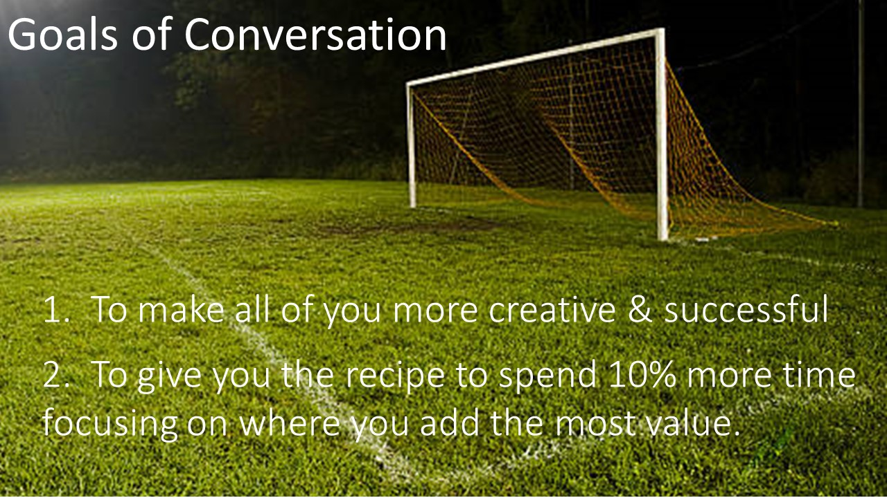
Notes:
My goals of this short conversation:
I would really like this presentation to help all of us be more successful, and to be more creative.
To give you a recipe so that you can talk to your manager about how you can physically carve out 10% of your time to do something where you add the most value. For me that is innovation, but for you it may be something else.

Slide 4

Notes:
Before I begin, a few disclaimers
I will cover a lot of information quickly, so please email me if you want a copy of this presentation
None of this is original to me. It is either information I have read over the years, or been taught to me by mentors

Slide 5
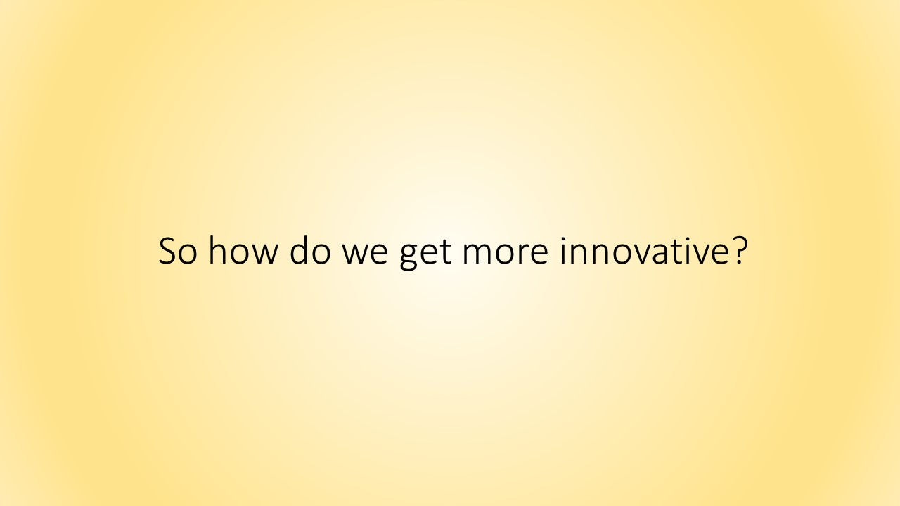
Notes:
So how do we get more innovative

Slide 6
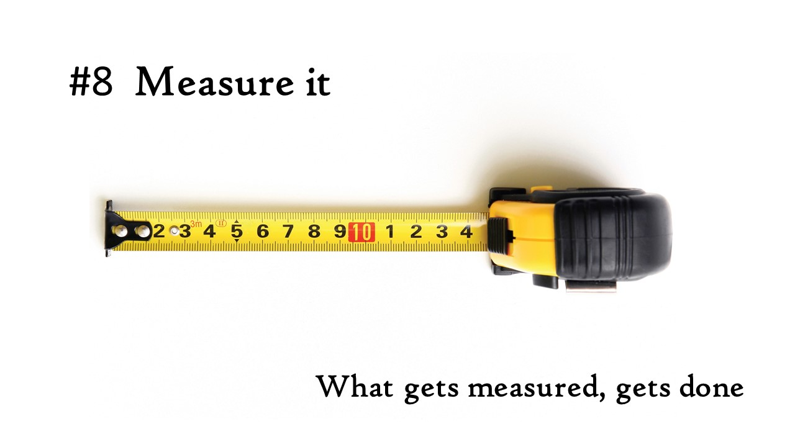
Notes:
#8 Measure it. What gets measured gets done

Slide 7
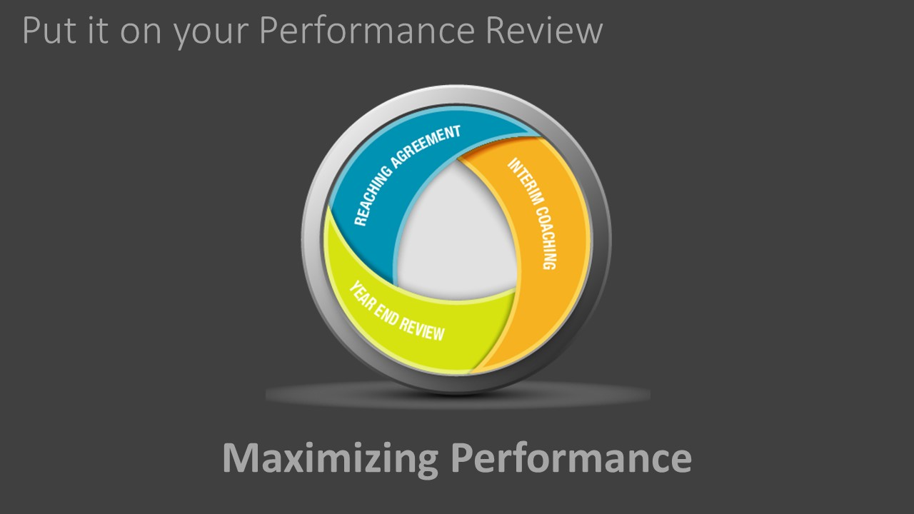
Notes:
A great way to measure it is to put it on your Performance Review. Make being creative or pushing innovation part of your success criteria

Slide 8
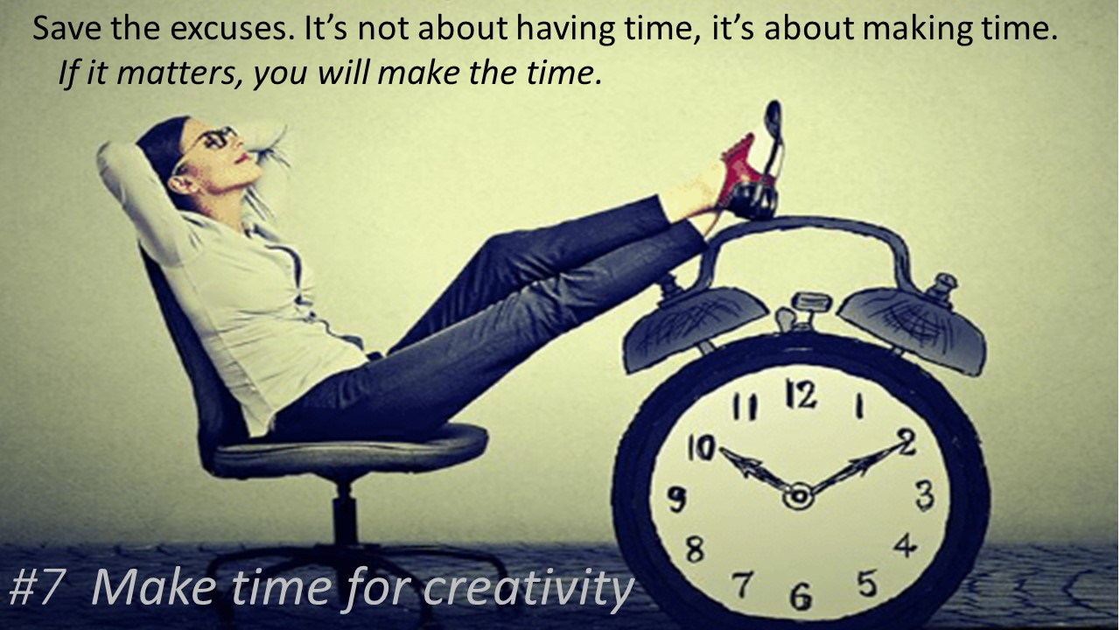
Notes:
#7 Make time for creativity. Schedule and use flex time. You can have all the good intentions you want, but if you don’t put it on your calendar or make time for it, it won’t happen.

Slide 9
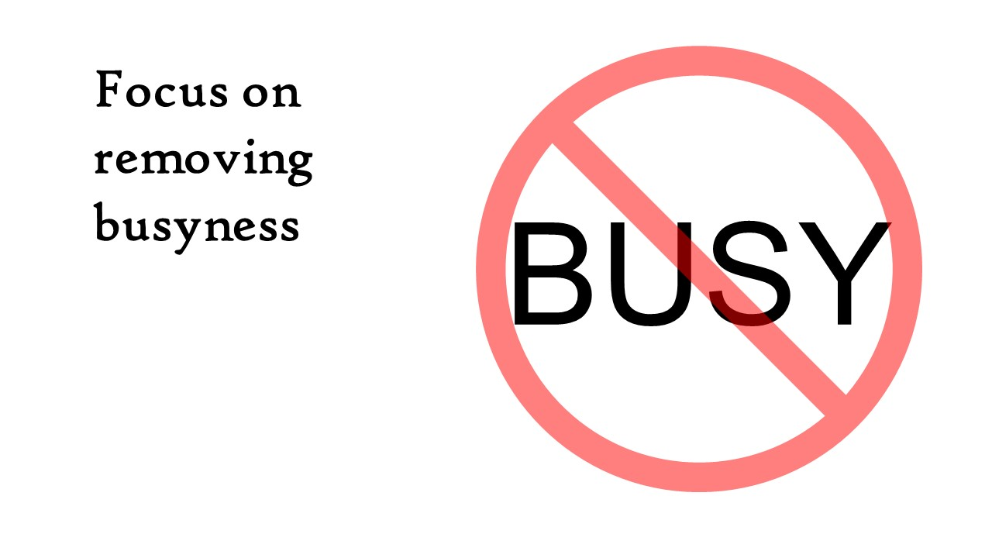
Notes:
It is hard to be creative when you are busy. Almost everyone I talk to is busy. But, the really successful people I talk to never talk about being busy. They are doing 6-10 times more than I do in a given day, and never once do they claim to be busy. They are just doing stuff. So if we focus on not being busy it will free up some time, or at least mentally change our attitude.

Slide 10
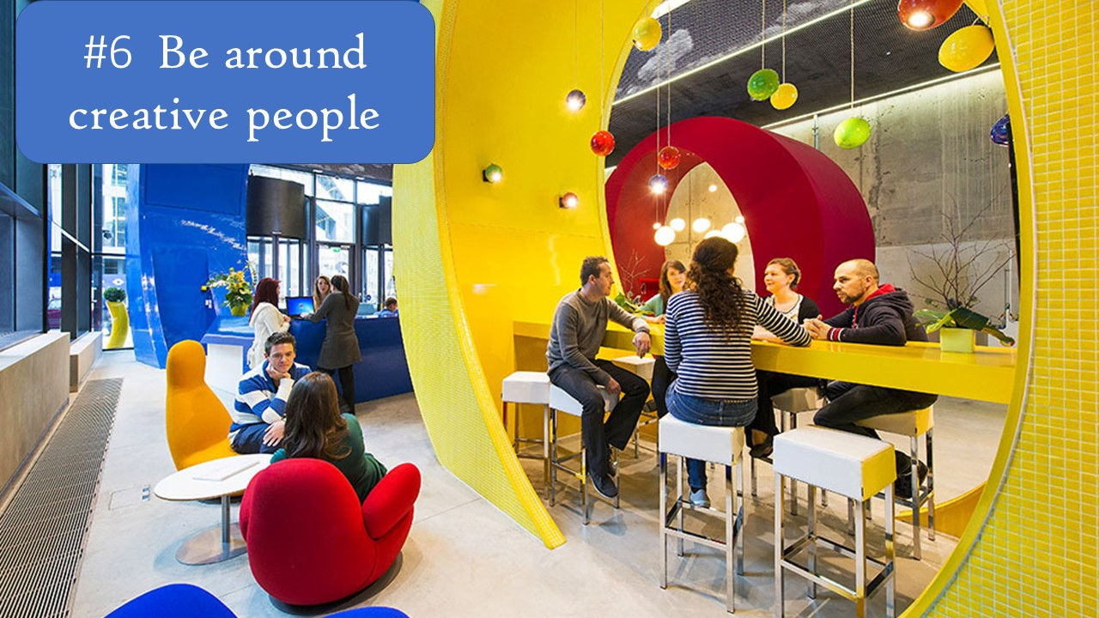
Notes:
#6 Be around creative people. Something I learned… When I am around creative people; I am more creative.

Slide 11
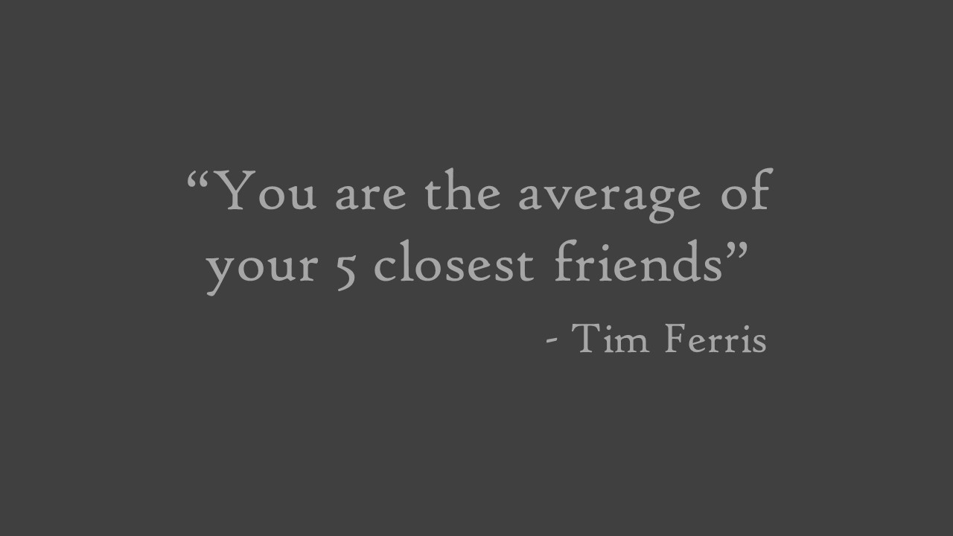
Notes:
I listen to a lot of podcasts, and one of them is the Tim Ferris Show. I often hear him recite this quote. Growing up my grandma had a similar saying “Birds of a feather, flock together”. She was using that because I was a trouble maker, and all of my friends were trouble makers, but the point is that it correlates to my work now. If your at work, and the people you hang out with the most happen to be a certain way, you tend to be that way. If you hang out with negative people you will typically be negative. If you hang out with positive people, you will likely be positive.

Slide 12
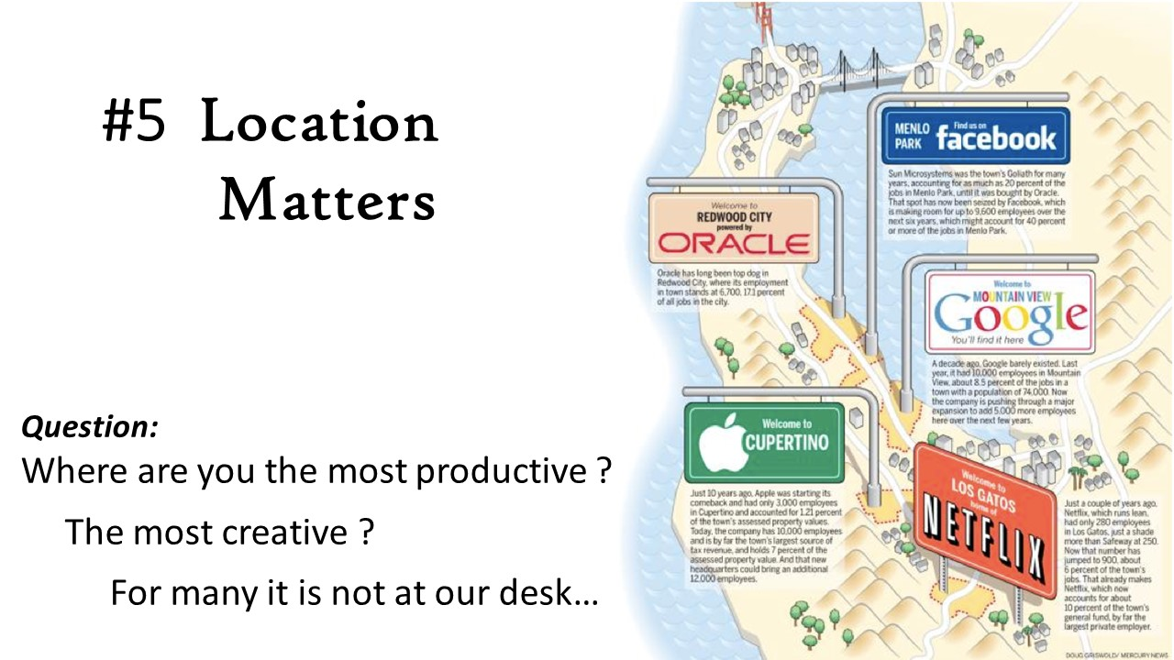
Notes:
#5 Location. Being around creative people is why so many top companies are located clusters. Where are you the most creative? Can you schedule more time in that location??

Slide 13
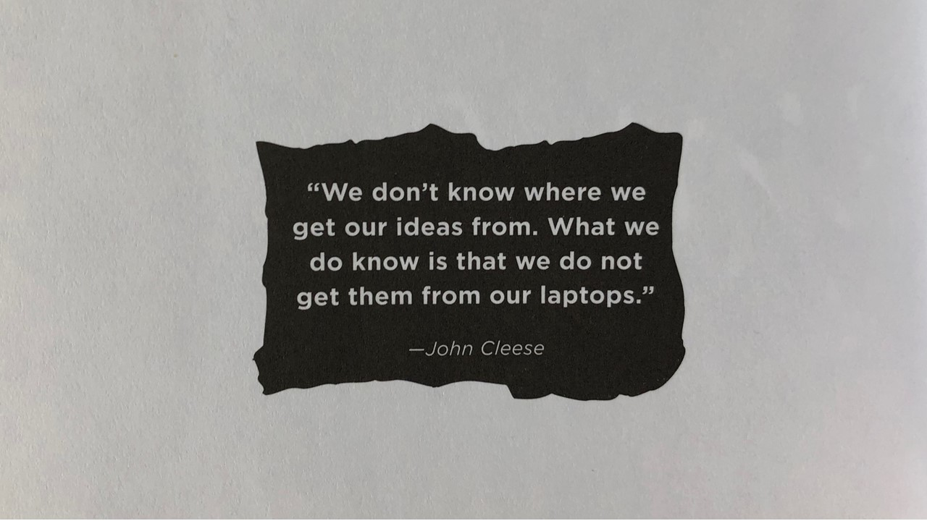
Notes:
Austin Kleon says to “Step away from the screen”. To unlock your creativity he says you need to use your hands. Designers are really good at this, they will get a book and start sketching, but a lot of us just use the laptop for everything.

Slide 14
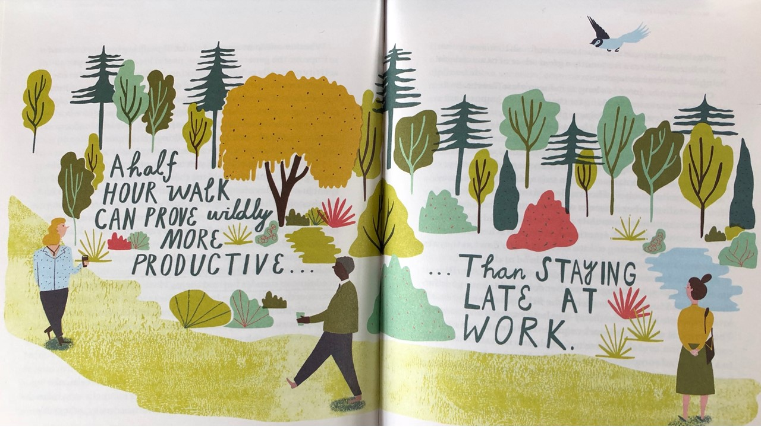
Notes:
Margaret Heffernan, best known for TED talk on “super chickens” has a book called Beyond Measure. In this book she states, “When it comes to time, most organizations are very good at measuring its quantity but poor at measuring its value. We need time for quiet, focused work. We also need time to let our minds wander and find the insights and inspirations no amount of focus will ever bring.

Slide 15
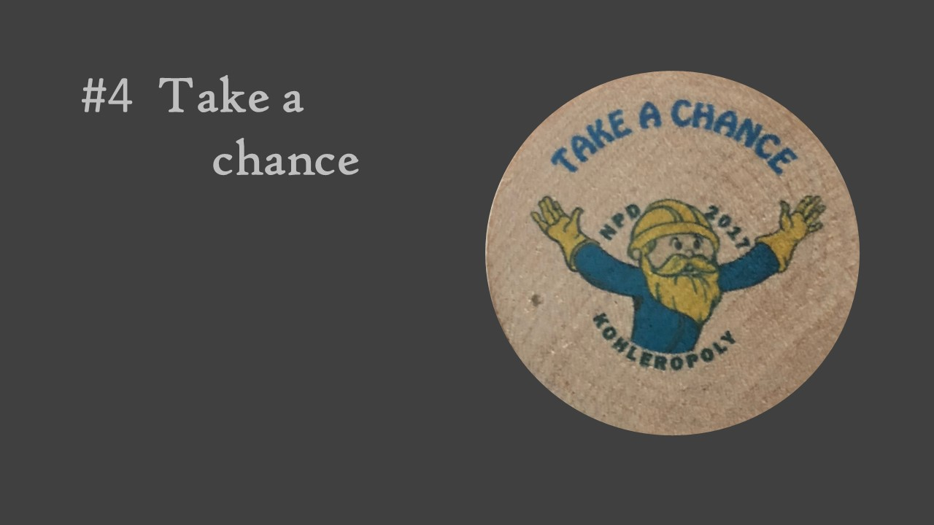
Notes:
#4 Start taking some chances. I am taking a chance giving this presentation. I am not typically a formal speaker, nor do I do slide decks. I actually hide behind really good models. Most of my career has been on making really good prototypes, so that most of the focus in on the prototype, not on me.

Slide 16
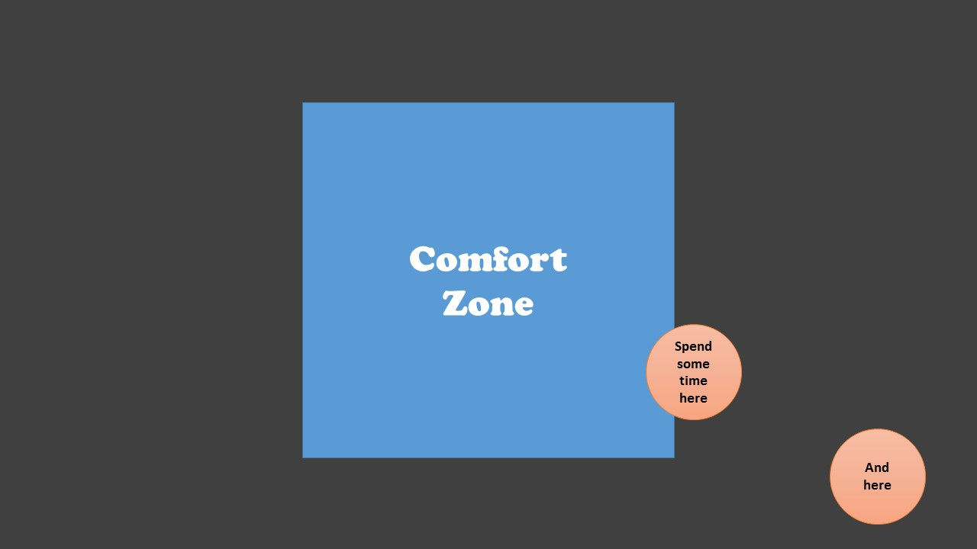
Notes:
Spend a little bit of time outside your comfort zone. This is where real growth will occur… From my experience a lot of happiness comes from growth.

Slide 17
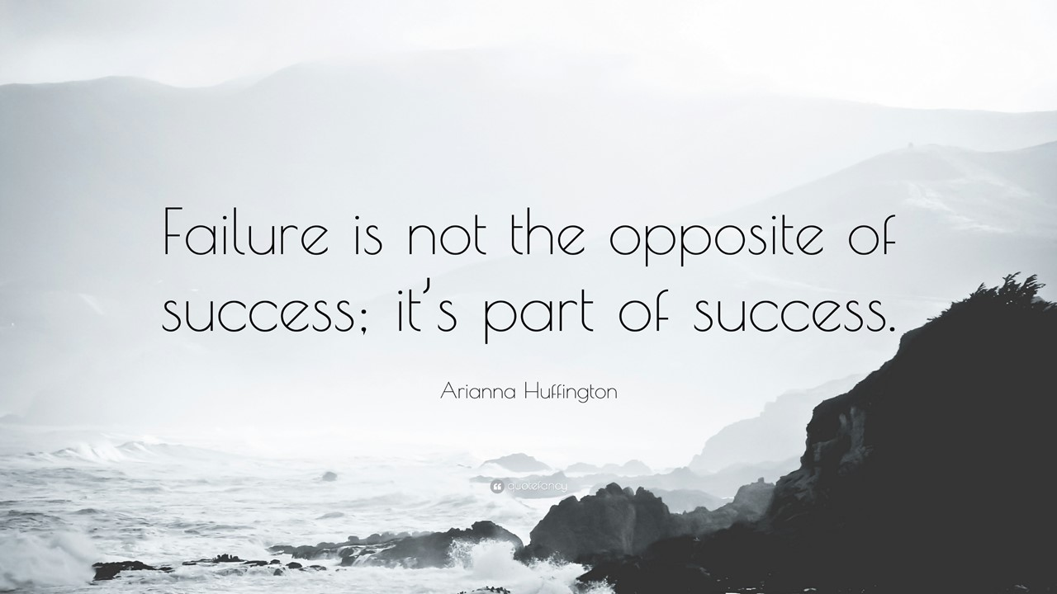
Notes:
Realize Failure is not the opposite of success, it’s part of success. In a recent podcast Arianna Huffington said it is a stepping stone on the path to success. I really like this analogy of a stepping stone because a lot of projects are a series of micro-failures until we get to success. So every failure is not a setback, its actually a step towards the solution.

Slide 18
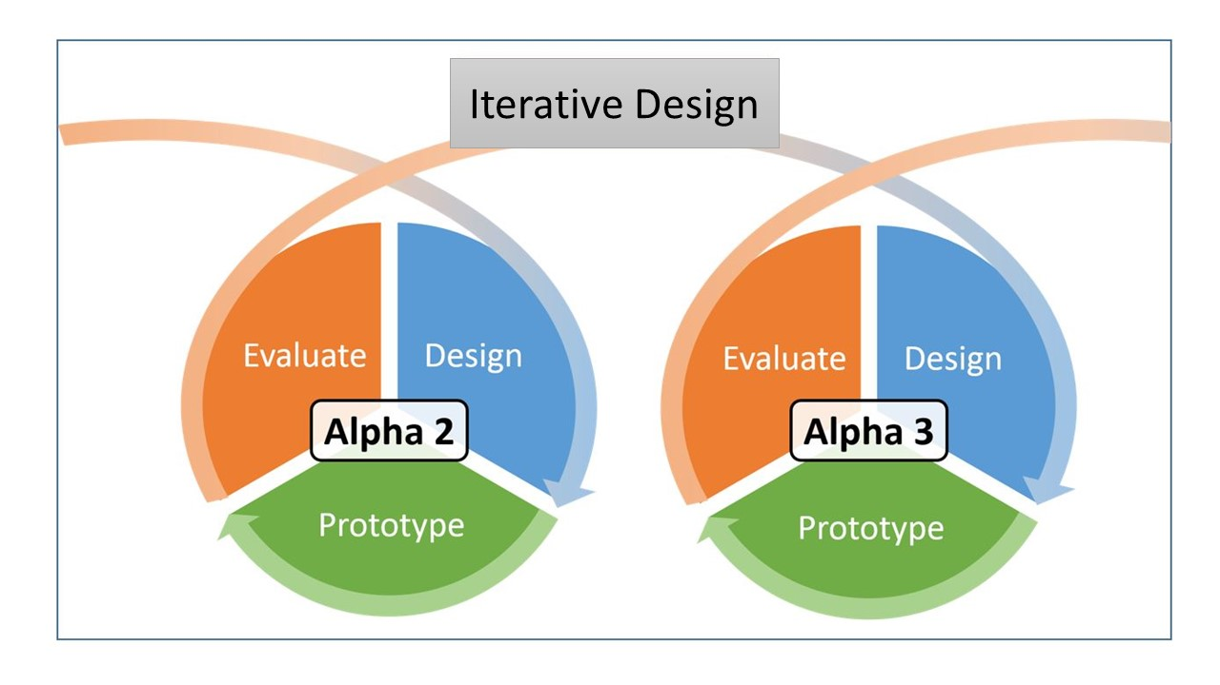
Notes:
This is why I love Iterative design. You do these short sprints, maybe they take a week. You design, build and evaluate an idea, and then you do it again, and maybe again. Because these are short sprints you can afford to make mistakes. I use the analogy a lot that you learn more from a bad prototype than a good prototype. When something is bad you get a lot of feedback. When something is good everyone is quiet or simply say’s “yeah, that is good”, and you learn nothing. Except maybe that you are closer to the finish, which is a good thing.

Slide 19
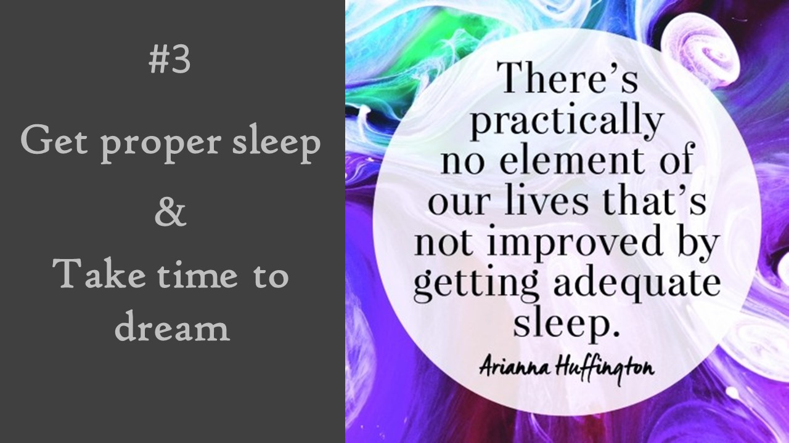
Notes:
The prevailing culture still believes that being always on is the way to succeed. That cutting down on sleep means being more productive as we have more time available. The latest science shows this is not factual or healthy.

Slide 20
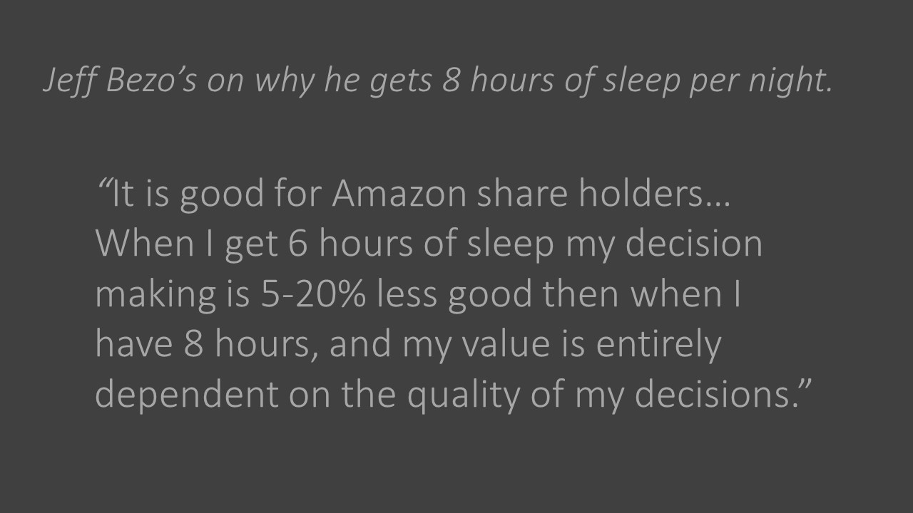
Notes:
Jeff Bezo’s has a great quote on this, but one that I learned earlier was about James Dyson. I personally need at least 7-1/2 hours of sleep to be my best, when I was just starting my career as a young engineer I really liked Dyson, and I was amazed to learn that he tries to spend 8-1/2 hours a day laying down. He doesn’t sleep all 8-1/2, but he lays there. If he wakes up in the middle of the night he will use that time for a short meditation. If he awakes earlier than he needs to, he will use that time to focus his thoughts for the day or allow his mind to wander.

Slide 21

Notes:
Peter J Daniels, in his book How to Reach your Life Goals states, “Do not be too busy to dream, rather be busy dreaming. Cut your busy schedule and go alone to a quiet spot with a pen and paper and dream, imagine, plot, talk to yourself and think. This could be the most profitable time of the week.”

Slide 22
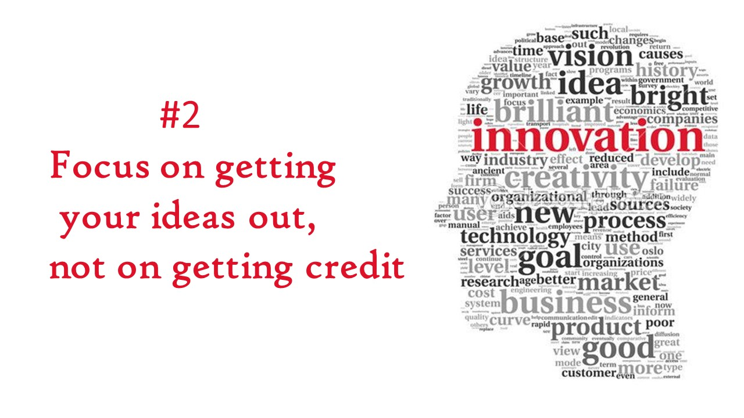
Notes:
#2 Focus on getting your good ideas out, not on getting credit. This was a big breakthrough for me personally. Earlier in my career I would often treat ideas like a strategic card game and hold onto the good ones until I could play them to get the most benefit. As I matured I realized both I and Kohler benefited more by getting these ideas out early and allowing others to build on them.

Slide 23
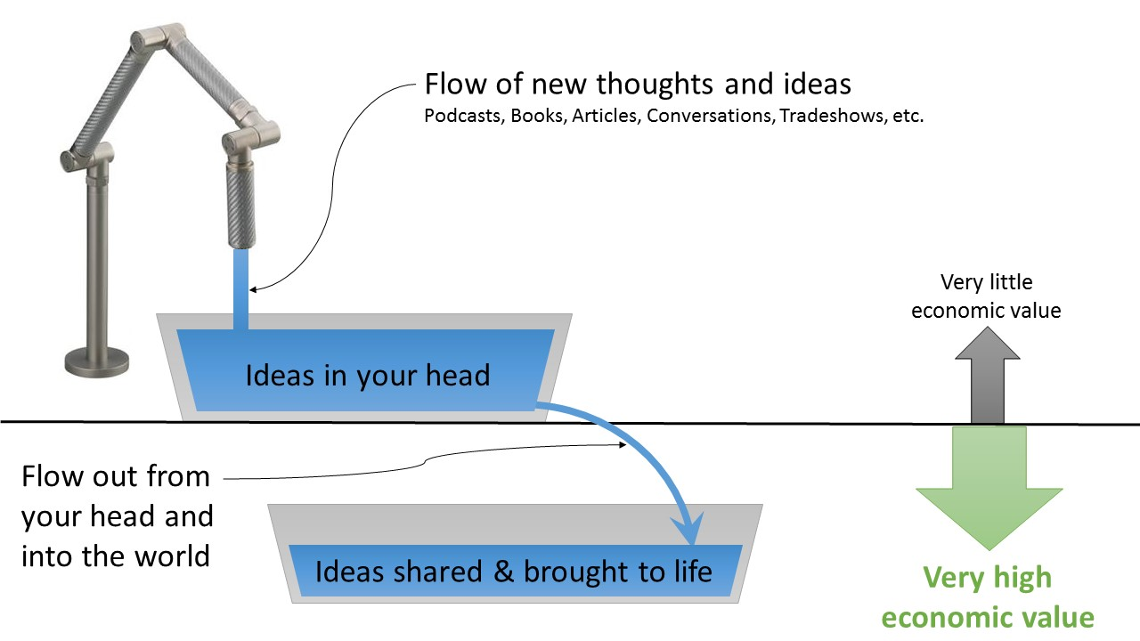
Notes:
Creative people realize that both the flow into your mind and the flow out of your mind are critical to success. They also realize that the flow out is more important as ideas only create value after the leave your head.

Slide 24
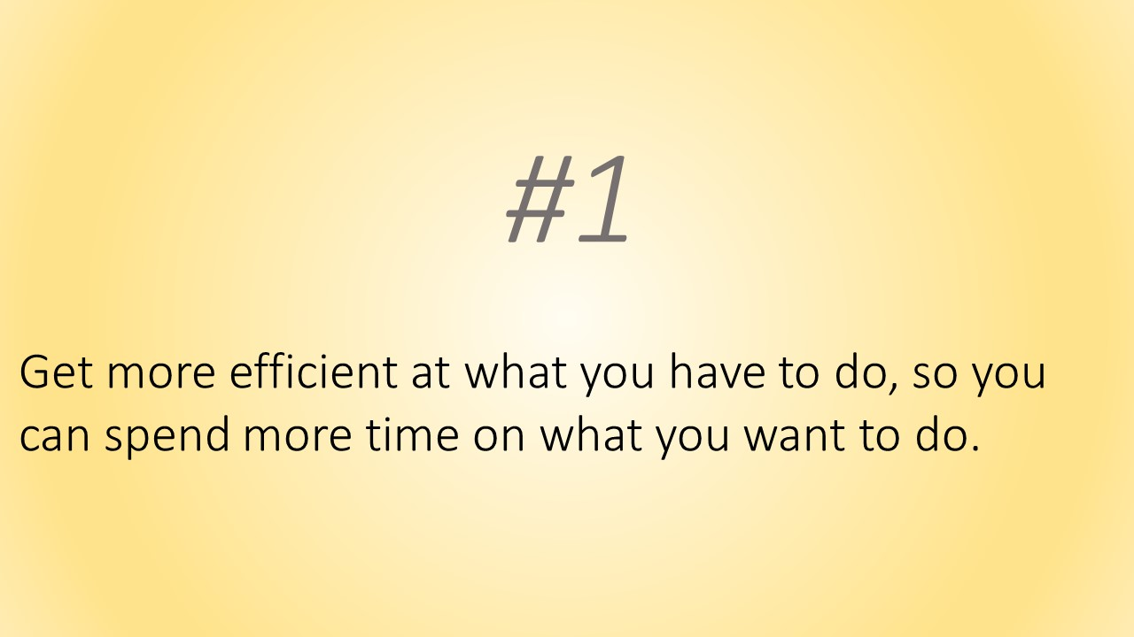
Notes:
#1 Get more efficient at what you have to do, so you can spend more time on what you want to do.

Slide 25
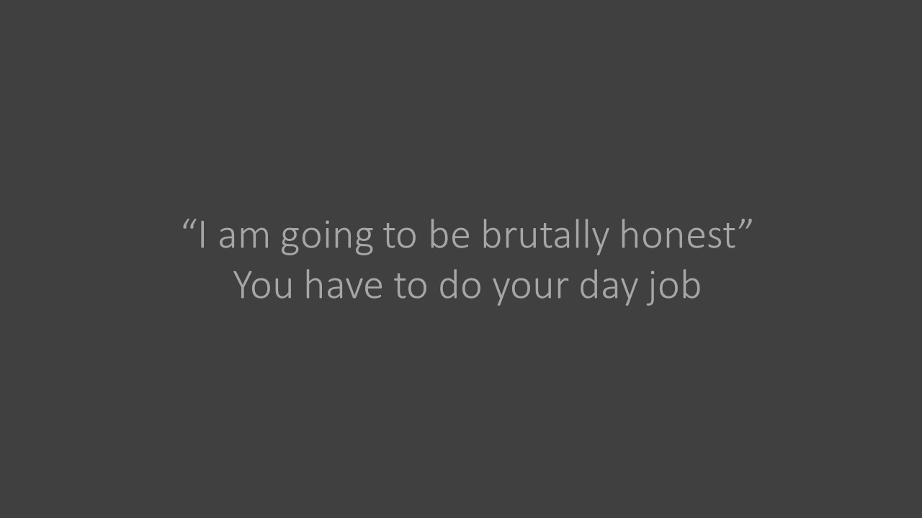
Notes:
As I stated earlier… My goal is that everyone works 4-8 hours less per week. However, our managers still expect us to get all of our work done…

Slide 26
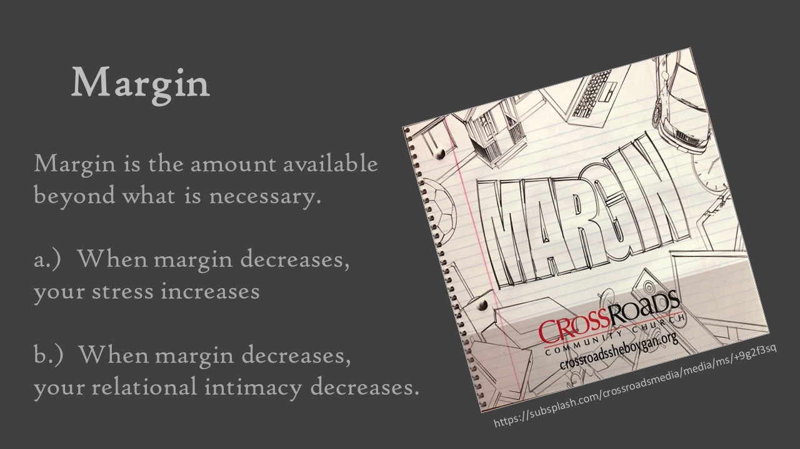
Notes:
Home run schedules do not have any margin….
I believe that we should end all meetings 10 minutes earlier (meetings should end on the :20 or the :50) This allows everyone a chance to go back to their desks, collect their thoughts, maybe send out a short email. AND then all meeting should start on time. We at Kohler have this idea that all meetings are on call. Just because the chairman has that luxury, doesn’t mean that we should. We have to start on time.
https://subsplash.com/crossroadsmedia/media/ms/+9g2f3sq

Slide 27
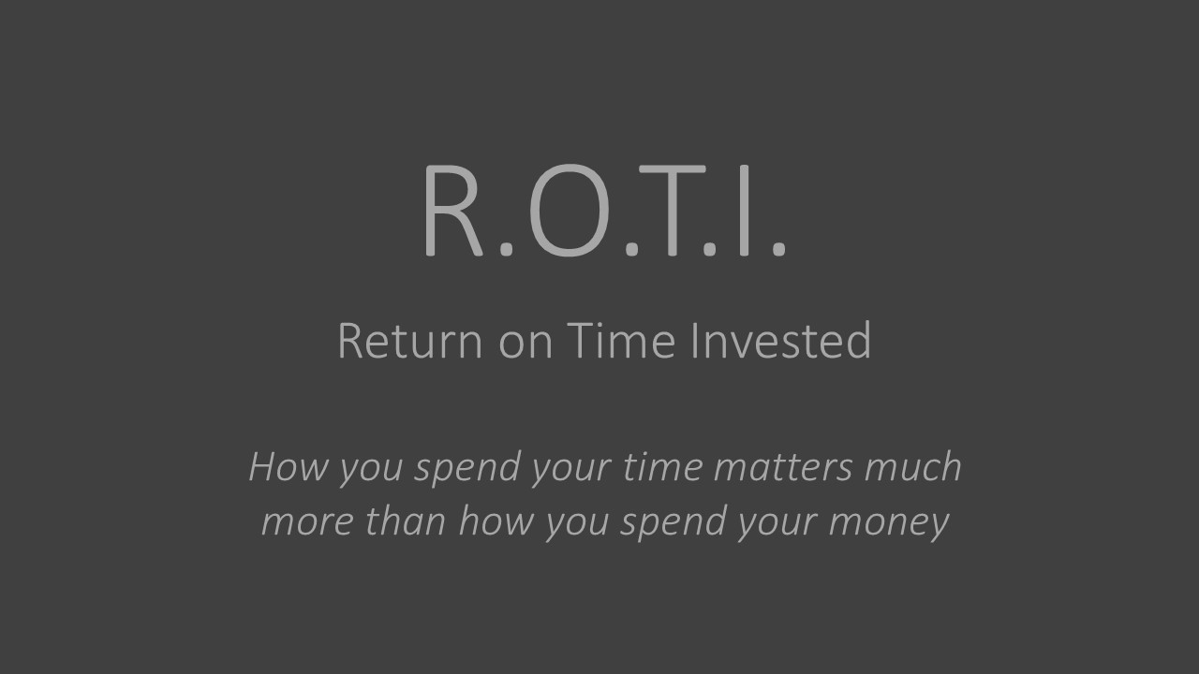
Notes:
Everyone has heard of ROI (Return on Investment), but less people think about Return on Time Invested. I think we need to be more deliberate with our time. We only have an allotted amount of time, and when its gone, its gone.

Slide 28
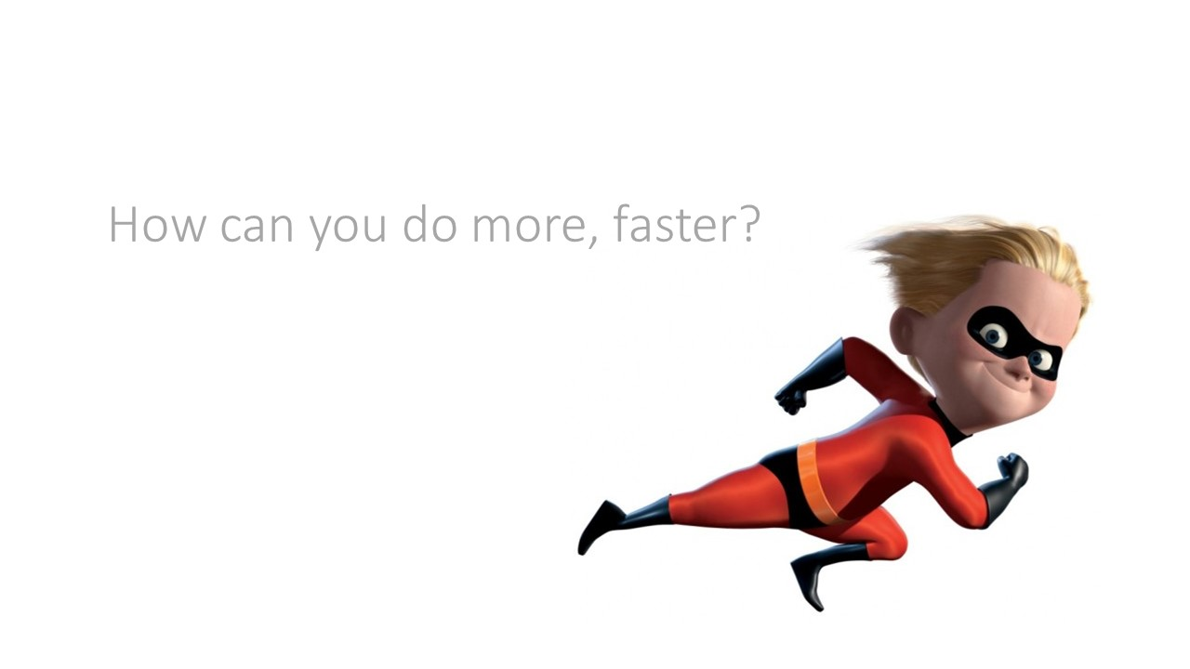
Notes:
How can you do more, faster. I know management will eventually ask you this. How can I do my job plus the work of the guy next to me?

Slide 29
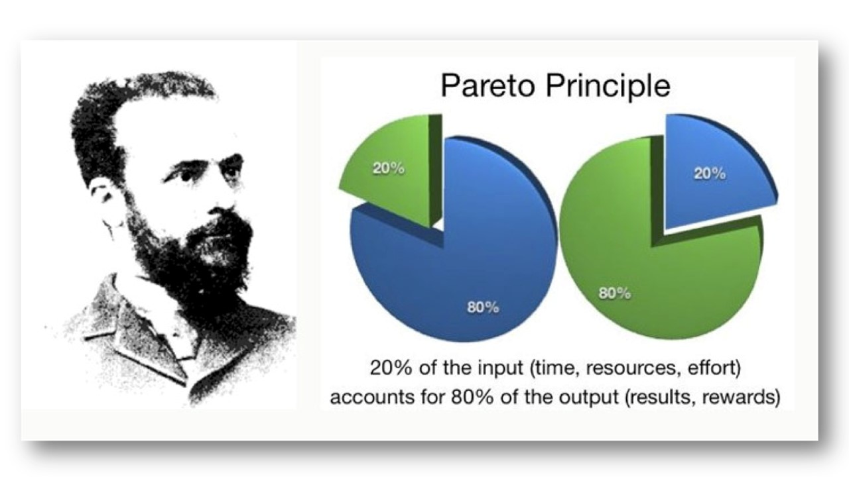
Notes:
A good start is to analyze your time and determine where you get the most results.
The 80/20 rule… 20 percent of your activities will account for 80 percent of your results.
Meaning that 80% of your time is not necessarily that productive (well in terms of producing results that is)…

Slide 30
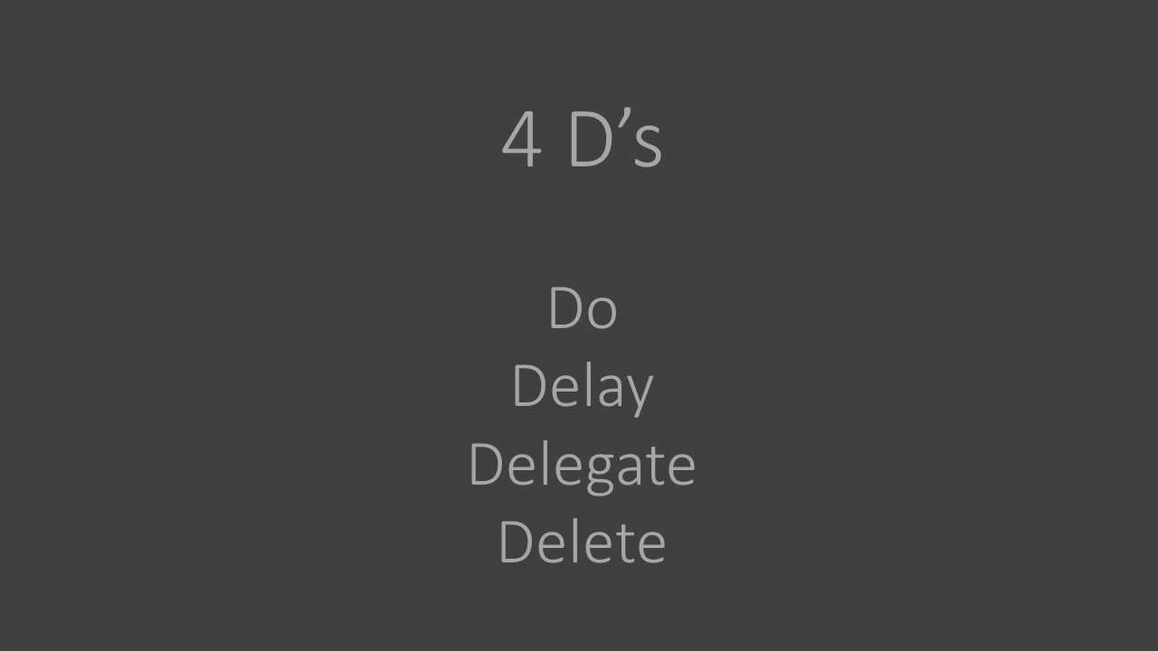
Notes:
A few years ago my manager shared with me the idea of the 4 D’s. When you get a task run them through this filter of the four D’s… and spend just a little bit of time to determine what you should do with each task.

Slide 31
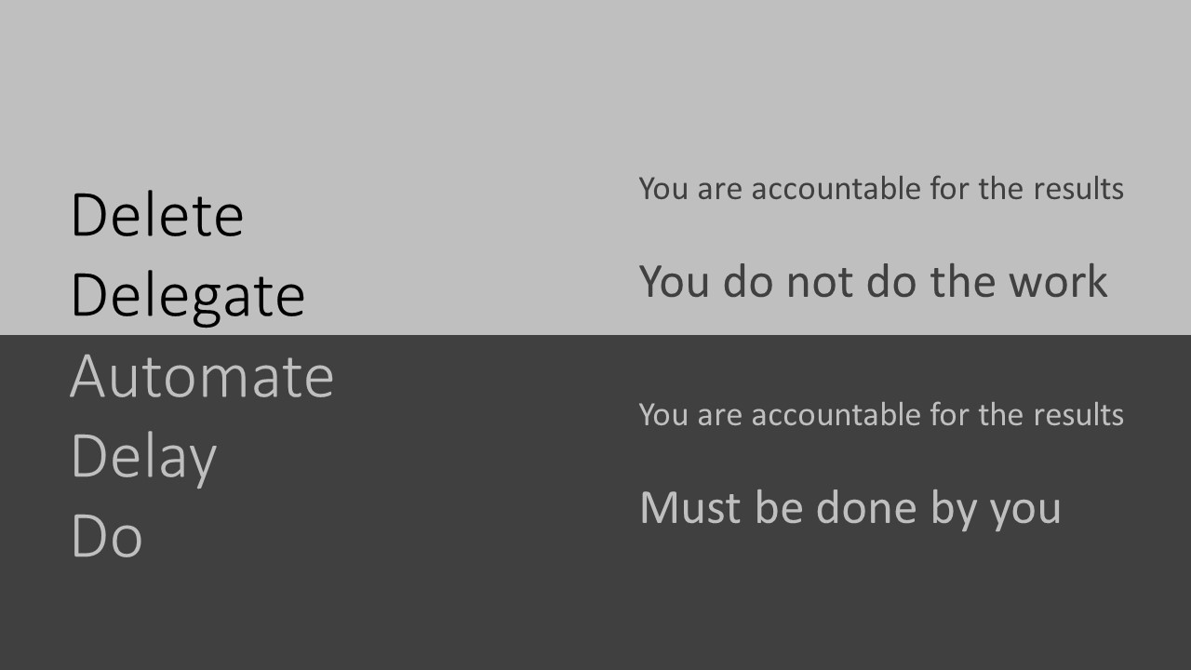
Notes:
Rory Vaden, in his book Procrastinate on Purpose builds on this, and adds Automate to the list. It is important to note that you are accountable for the results regardless, but you do not have to do the work. So lets dig quickly into each…

Slide 32
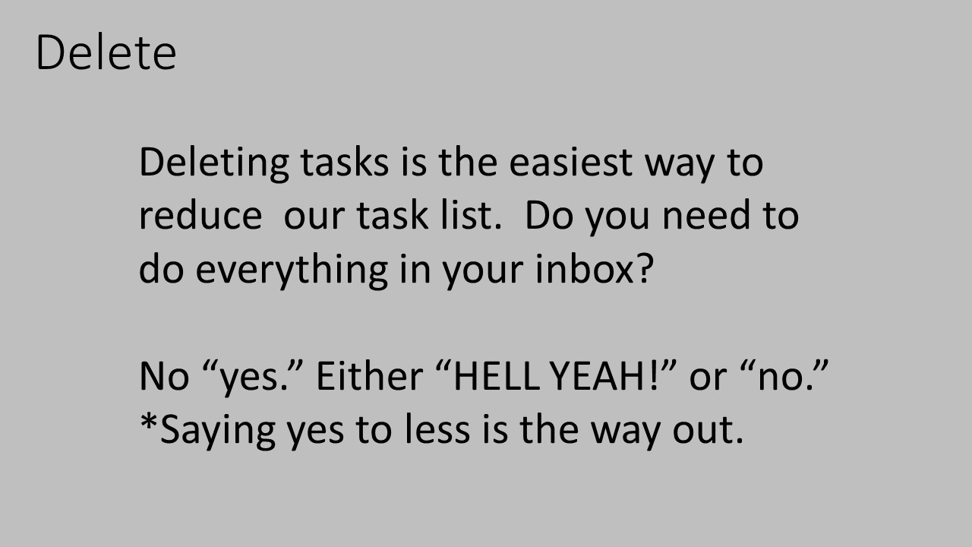
Notes:
Deleting tasks is the #1 to reduce our task list. So we need to be honest with ourselves and ask is everything that comes to my inbox something I need to do.
No “yes.” Either “HELL YEAH!” or “no.”
Use this rule if you’re often over-committed or too scattered.
If you’re not saying “HELL YEAH!” about something, say “no”.
When deciding whether to do something, if you feel anything less than “Wow! That would be amazing! Absolutely! Hell yeah!” — then say “no.”
When you say no to most things, you leave room in your life to really throw yourself completely into that rare thing that makes you say “HELL YEAH!”
Every event you get invited to. Every request to start a new project. If you’re not saying “HELL YEAH!” about it, say “no.”
We’re all busy. We’ve all taken on too much. Saying yes to less is the way out.

Slide 33
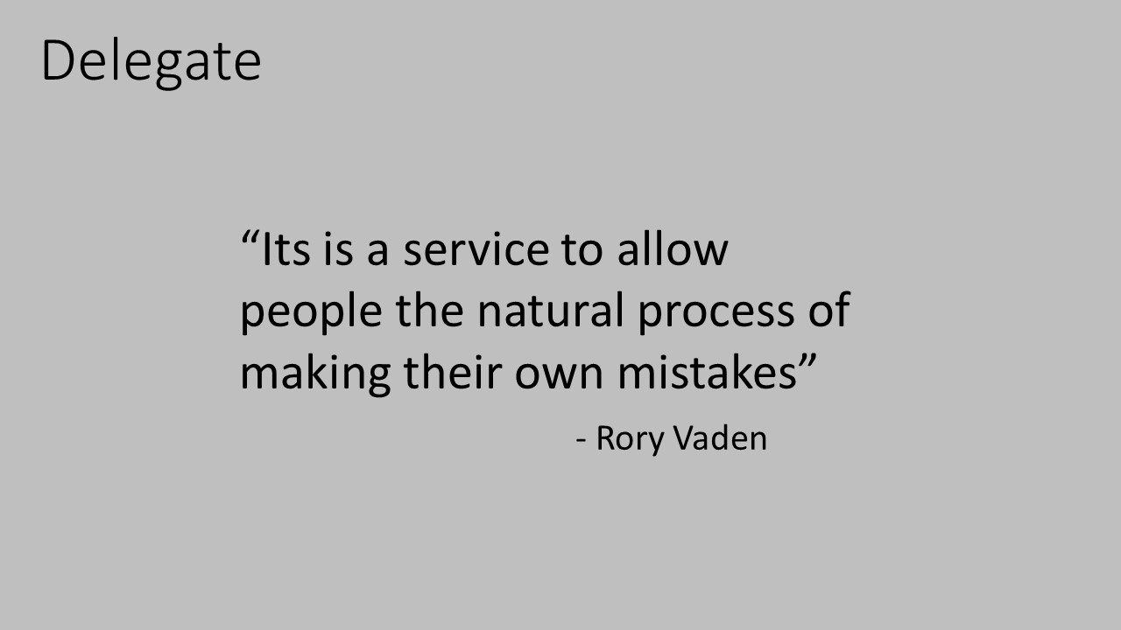
Notes:
As you do tasks though out the day ask yourself this: “Does what I’m doing right now require my unique skill set; or is it possible that there are other people capable of doing this?”
Rory in his book also states that it is valuable for you to spend up to 35 times the time it takes you to train someone else to do a common task. That by doing this you will see return on investment in less than one year. I took this to heart just recently. I was going to an event with my daughter and she wanted me to wear a tie that would match her dress. A tie means that I need to wear a dress shirt, which means I have to iron a dress shirt. 35 times huh, so I taught my daughter how to iron. You know ironing boards go really low… Its almost like they were made for child labor?.. It took her 20 minutes with my guidance, but she got a quarter and with a few more shirts she will likely be as efficient as me. Win – Win…

Slide 34
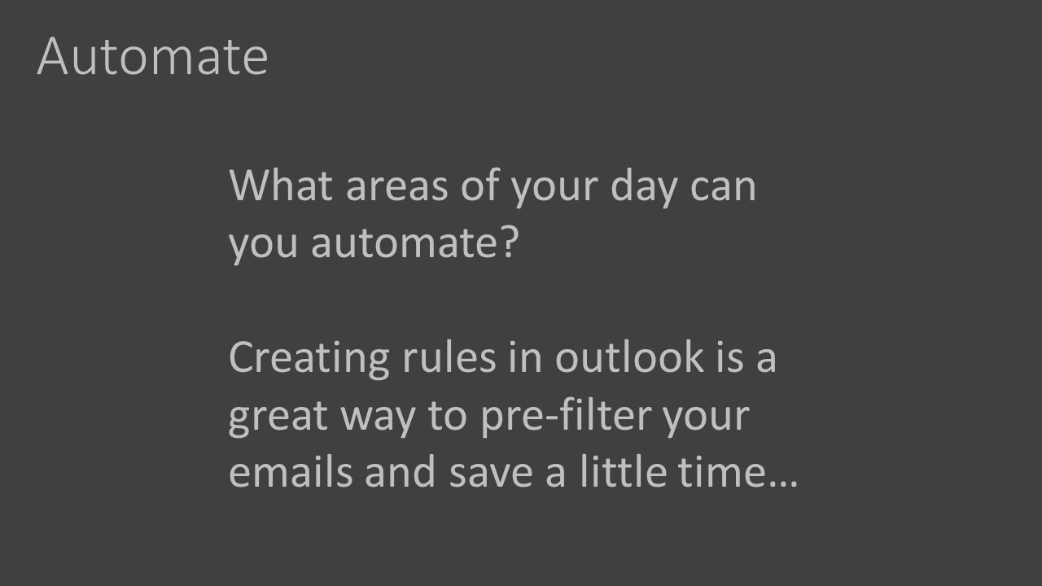
Notes:
Automate is not an area that I spent much thought until reading this book. So many things in my email are almost the same thing so I started creating “canned” responses that I could copy and paste and change just a few lines. Another thing is with Outlook you can create rules, and now a large amount of my emails automatically go to the correct folder. My inbox goes from maybe a hundred things a day to around 12. Occasionally I will get someone asking, “hey did you get that email” and I might have to search clutter, but honestly if its important they will ask again.

Slide 35
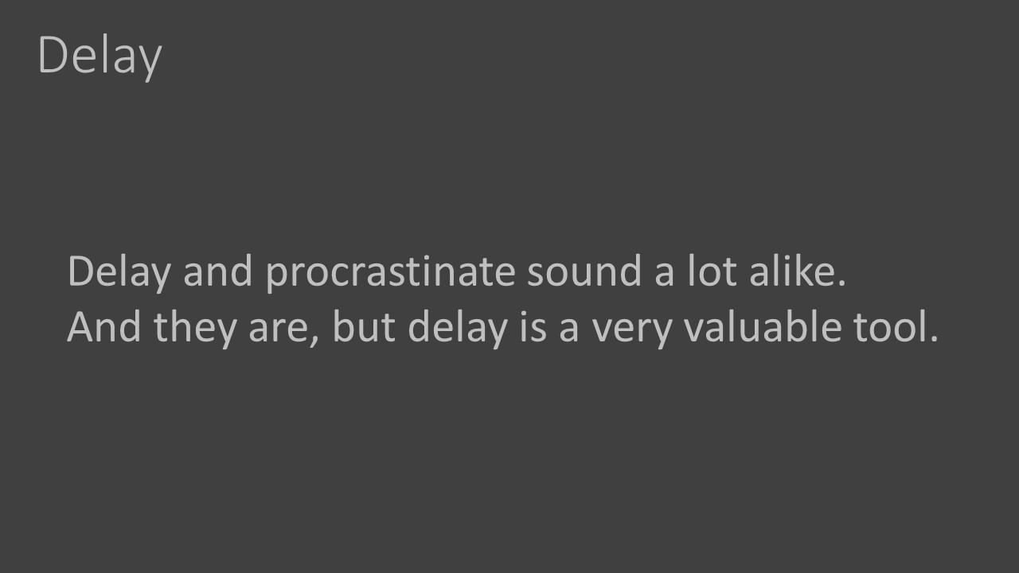
Notes:
Delay and procrastinate sound a lot alike. And they are, but delay is a very valuable tool. If someone gives you a task on Monday that is not due until Friday I advise that you don’t do it on Monday. In my experience a lot of tasks I am given change slightly as the time goes by. By simply waiting I can avoid some rework.
Another great ability with delaying is batching. A simple example is baking cookies. When I make cookies I bake an entire batch. This way I invest 40 minutes once, and I get cookies in seconds the rest of the week. Without batching you would need to allocate 40 minutes every time you had the desire for a cookie. Maybe a good idea for dieting, but definitely not efficient. This same idea works for email. Maybe you would be better served to read and answer email in batches. For some that might mean 30 minutes in the morning, 5-10 minutes around noon, and again 30 minutes at the end of the day. The rest of the time turn your email off and focus on your tasks at hand.

Slide 36
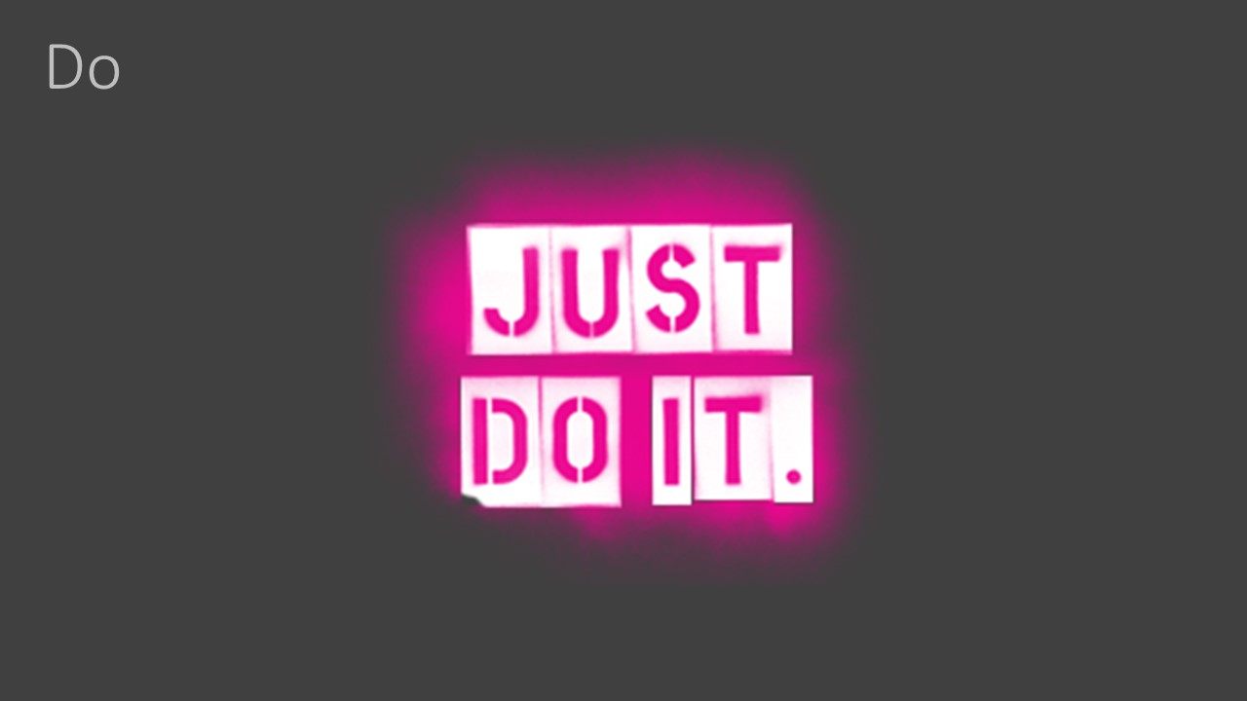
Notes:
At the bottom of the list is do it. When you get to this you must suck it up and just get it done.

Slide 37
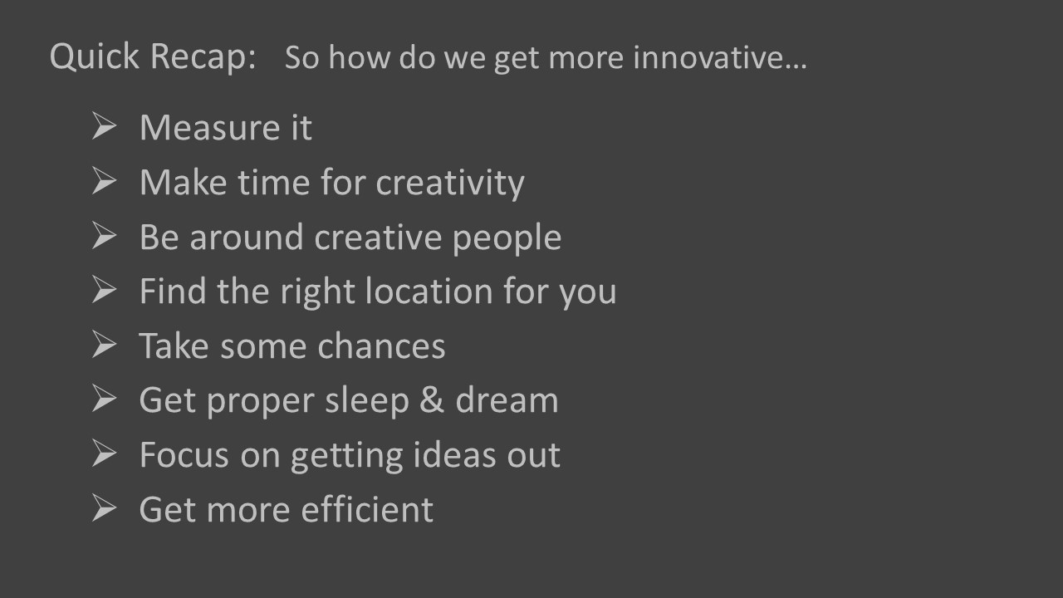
Notes:
AND… Have a conversation with your manager on how you can get more efficient with your tasks. Maybe it is using the 4 D’s, maybe its putting this on your Performance Review, Maybe its something else. Regardless, having this conversation will help both you, and your company, grow and improve.

Slide 38
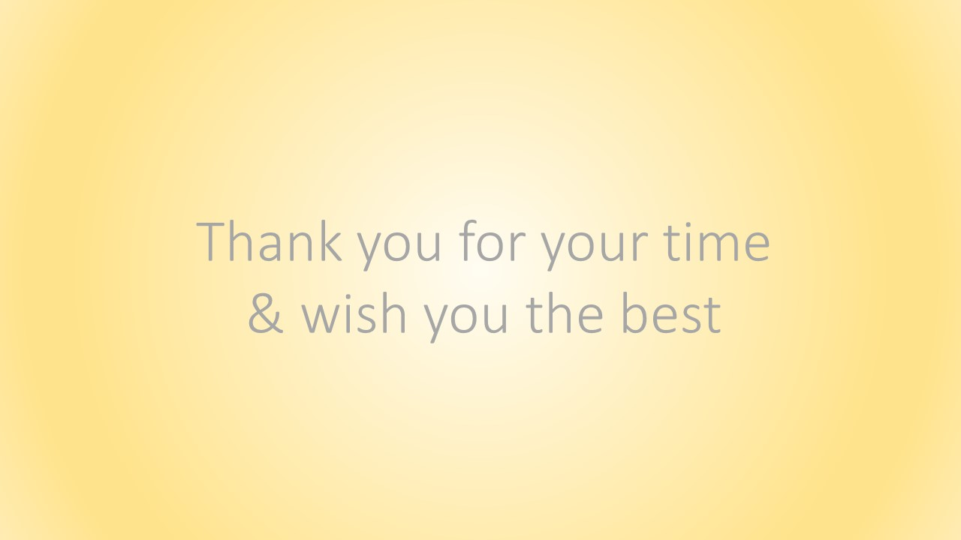
Notes:
I appreciate your time and wish you the best.
Any comments or questions feel free to email me at: douglas.diemel@kohler.com

Slide 39

Notes:
Appendix and links to source materials

Slide 40
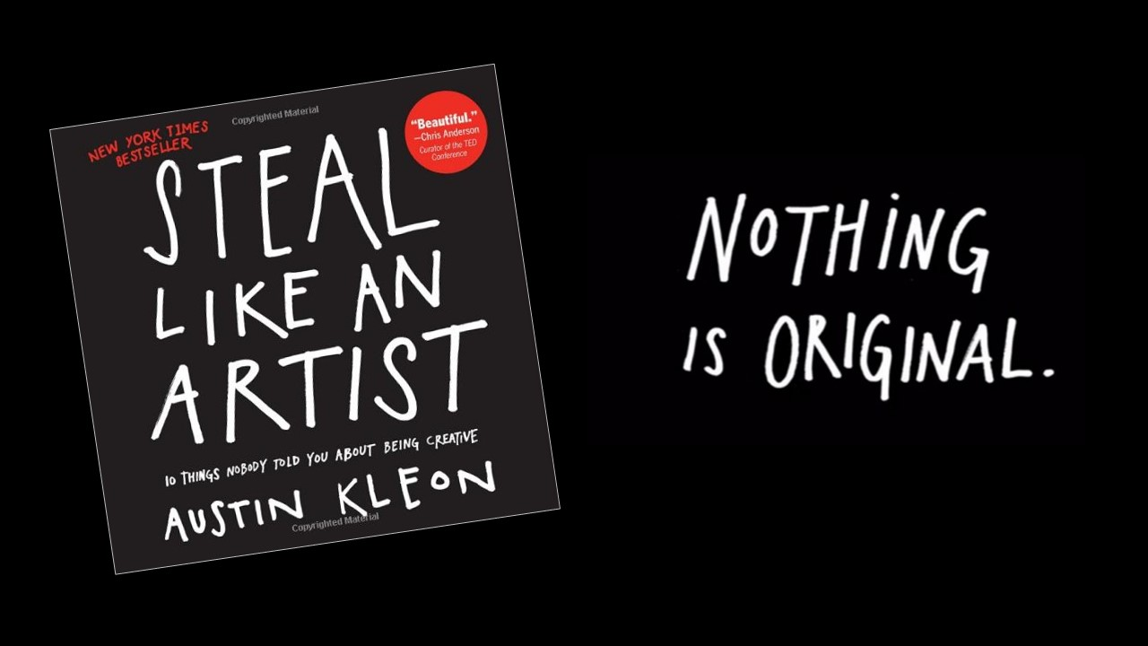
Notes:
Short, inspiring insights into creativity and the creative life: the day job, the mindset, etc. Also read his other book “Show Your Work”.
https://www.amazon.com/Steal-Like-Artist-Things-Creative/dp/0761169253/ref=sr_1_1?ie=UTF8&qid=1518568590&sr=8-1&keywords=steal+like+and+artist&dpID=51fIZsUhrpL&preST=_SX258_BO1,204,203,200_QL70_&dpSrc=srch

Slide 41
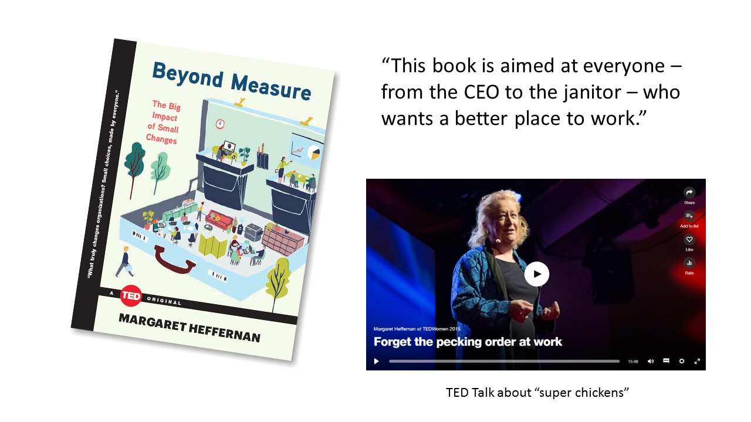
Notes:
https://www.ted.com/talks/margaret_heffernan_why_it_s_time_to_forget_the_pecking_order_at_work
https://www.amazon.com/Beyond-Measure-Impact-Small-Changes/dp/1476784906/ref=sr_1_1?s=books&ie=UTF8&qid=1518568626&sr=1-1&keywords=beyond+measure+by+margaret+heffernan&dpID=51QDZy-o9rL&preST=_SY291_BO1,204,203,200_QL40_&dpSrc=srch

Slide 42
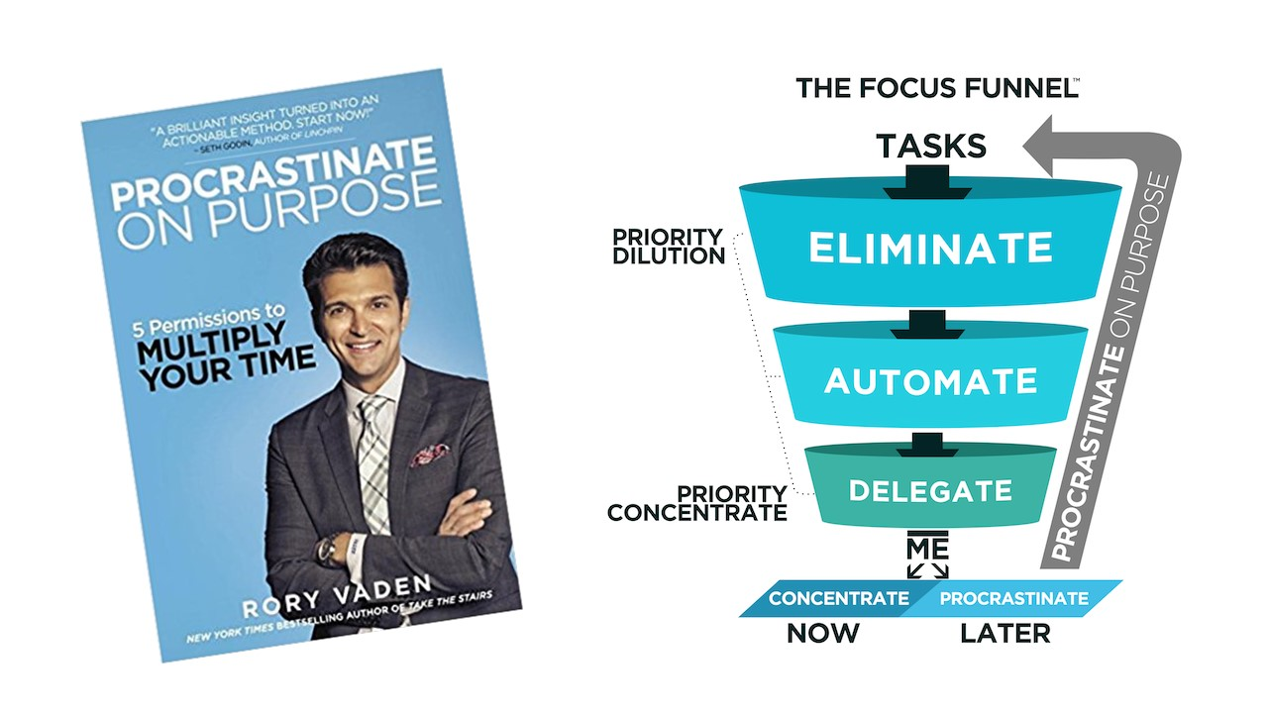
Notes:
https://www.southwesternconsulting.com/roryvaden/blog/the-focus-funnel/
https://www.amazon.com/Procrastinate-Purpose-Permissions-Multiply-Your/dp/0399170634/ref=sr_1_1?s=books&ie=UTF8&qid=1518568666&sr=1-1&keywords=vaden+procrastinate+on+purpose&dpID=51tEem9JNOL&preST=_SY291_BO1,204,203,200_QL40_&dpSrc=srch

Slide 43
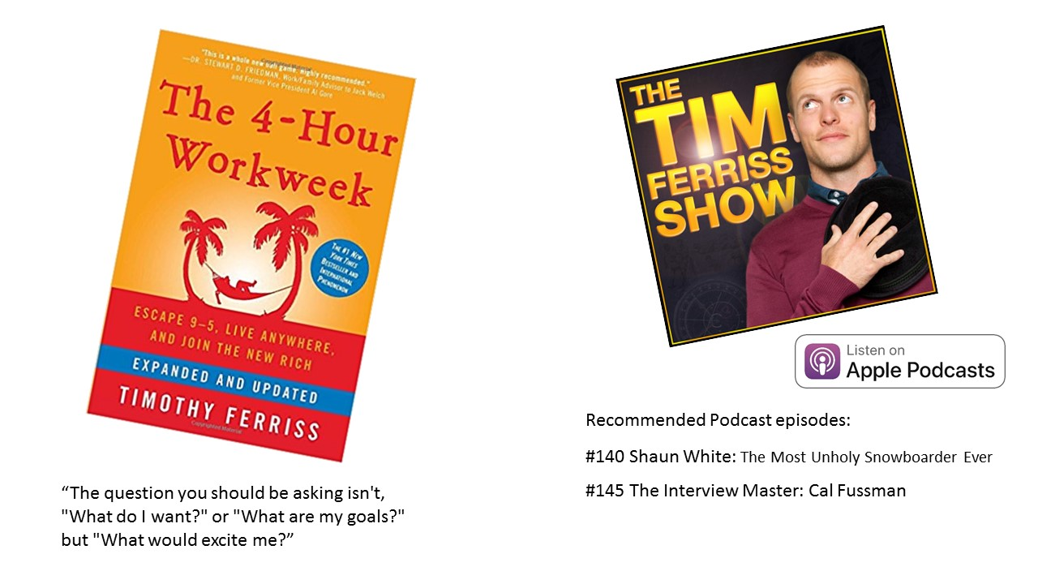
Notes:
https://tim.blog/podcast/
https://www.amazon.com/4-Hour-Workweek-Escape-Live-Anywhere/dp/0307465357/ref=sr_1_2?s=books&ie=UTF8&qid=1518568723&sr=1-2&keywords=tim+ferriss+4-hour+workweek&dpID=51v5Pje3AtL&preST=_SY291_BO1,204,203,200_QL40_&dpSrc=srch

Slide 44
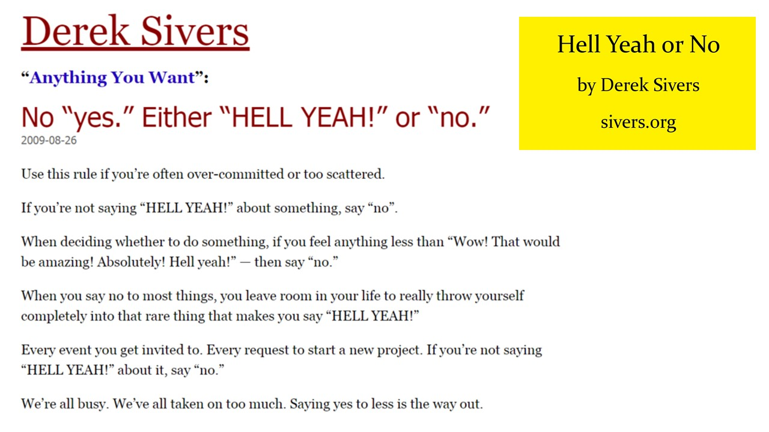
Notes:
https://sivers.org/hellyeah
https://youtu.be/1ehWlVeMrqw

Slide 45
Notes:
Margin is a past series at my church, Crossroads Community Church in Sheboygan. Link to the series is: https://subsplash.com/crossroadsmedia/media/ms/+9g2f3sq
Or learn more at http://crossroadssheboygan.org/

Slide 46
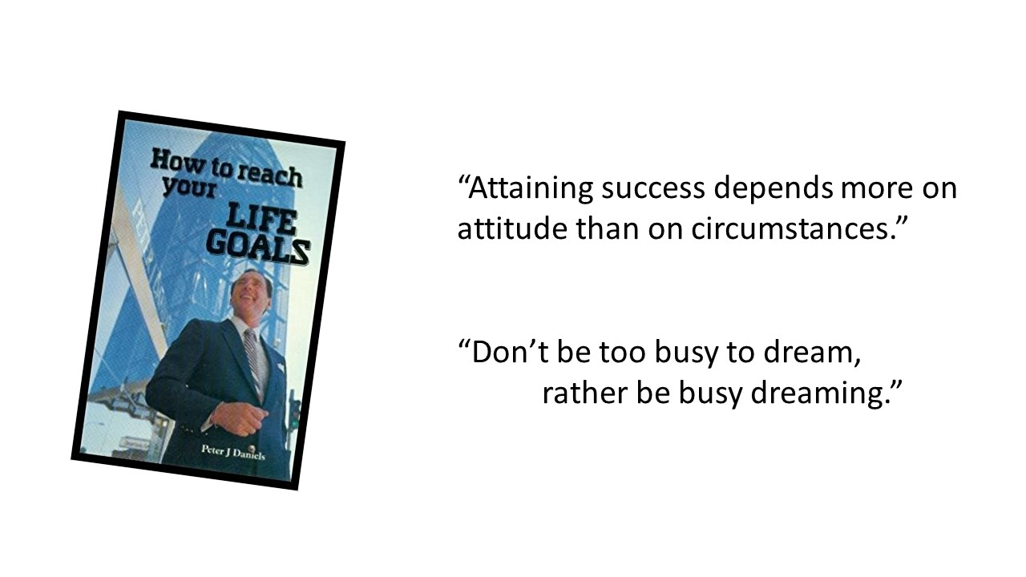
Notes:
I heard this man speak when I was young and was impressed with his energy and his story. I found his book to be a great tool for reflection, especially around Max P season. It is a rare book, and likely most copies were sold at one of his events. Regardless, if you ever want to borrow a copy from me let me know – Doug
https://www.amazon.com/How-Reach-Your-Life-Goals/dp/0949330078/ref=sr_1_1?s=books&ie=UTF8&qid=1518569074&sr=1-1&keywords=peter+j+daniels

Slide 47
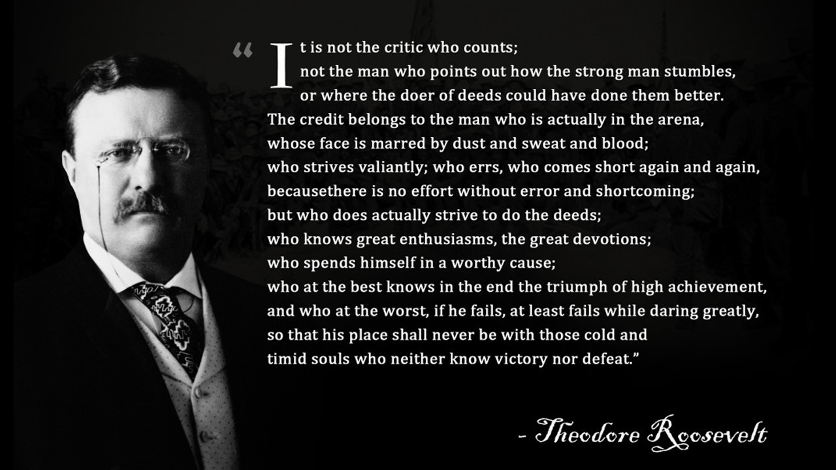
Notes:
The credit belongs to the man who is actually in the arena
What do you have to do to get into the arena?

Slide 48
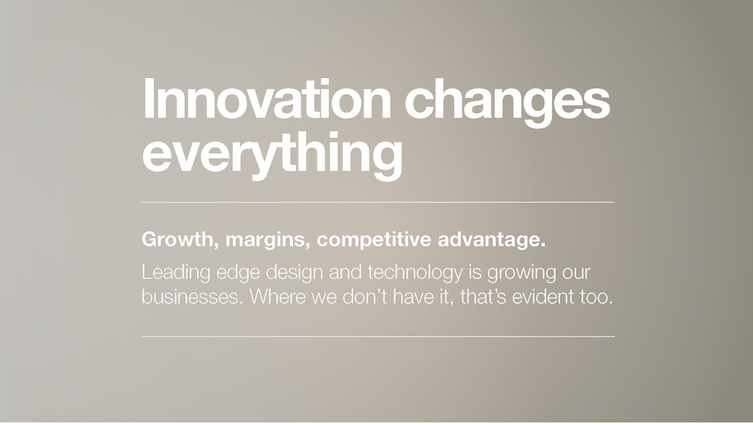
Notes:
From a David Kohler speech on Innovation in 2016

